Slide 1
Map and Map Interpretation 2542402
Lesson 1 : Introduction
Jittrapon Soontorn
Social Studies Program

Slide 2
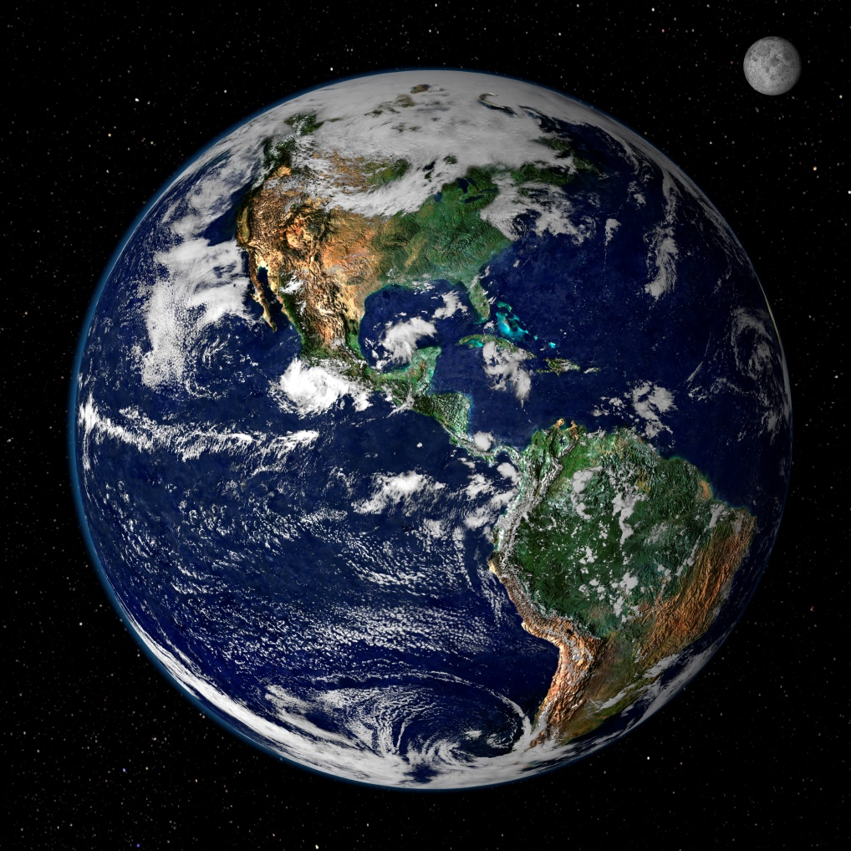
Meaning of “MAP”
“a drawing of the earth's surface, or part of that surface, showing the shape and position of different countries, political borders, natural features such as rivers and mountains, and artificial features such as roads and buildings:”
(Cambridge Dictionary)

Slide 3
Meaning of “MAP”
“A diagrammatic representation of an area of land or sea showing physical features, cities, roads, etc.”
(Oxford Dictionary)

Slide 4
Meaning of “MAP”
Conclusion
Tools
Describe or Present the Information of each places.
Writing on the plain such as paper

Slide 5
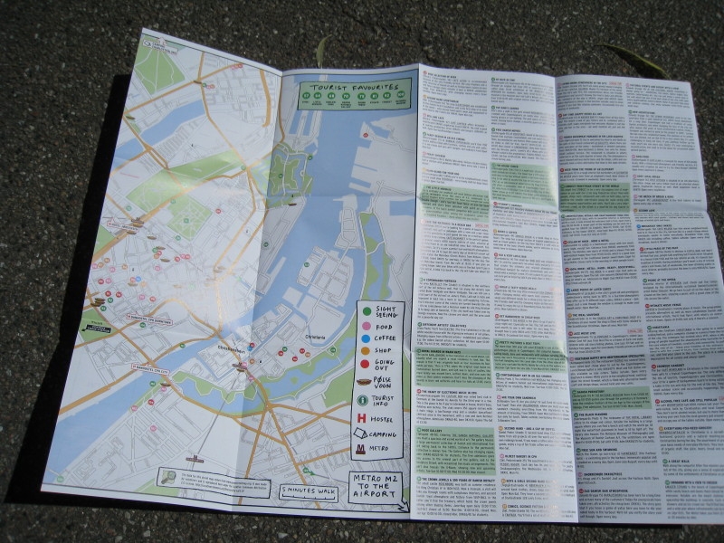
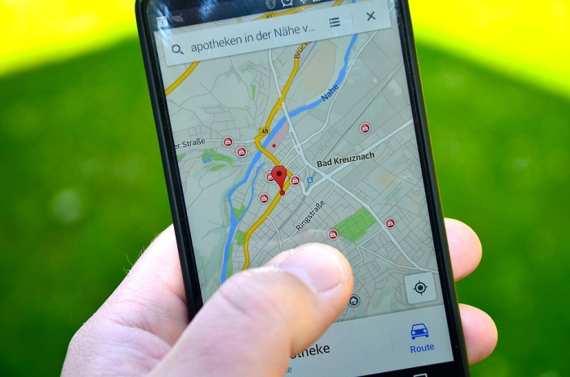
Types of maps in present
Printed Map or Paper Map
Digital Map

Slide 6
Printed Map
Normally use in every countries.
Variety purposes.
Navigating
Describing
Advertising
Planning
Military
Etc.

Slide 7
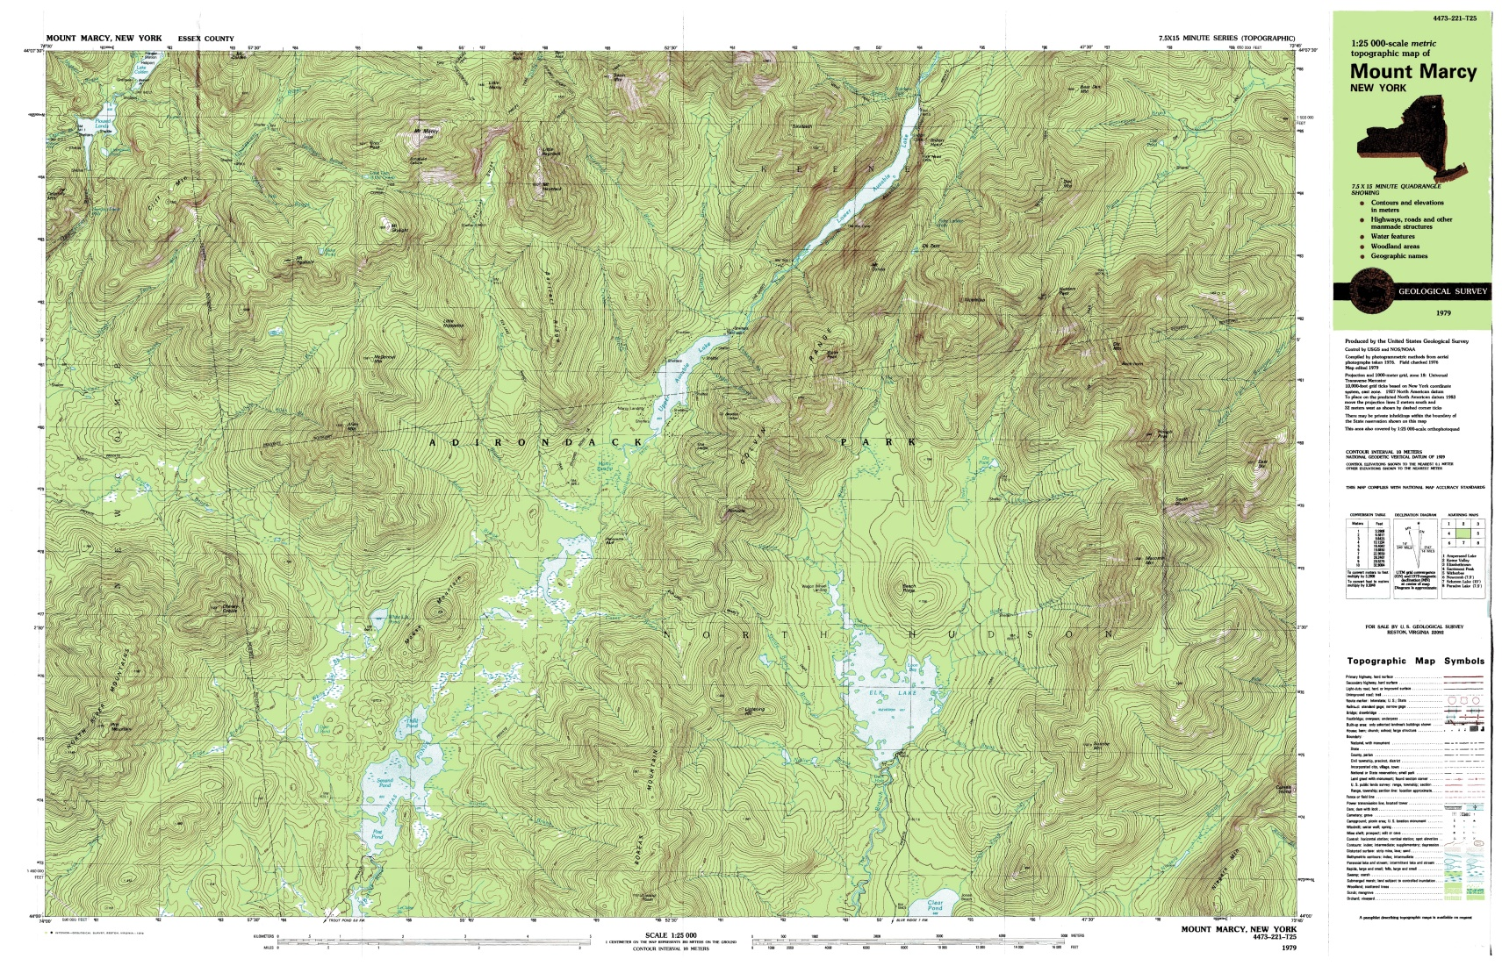
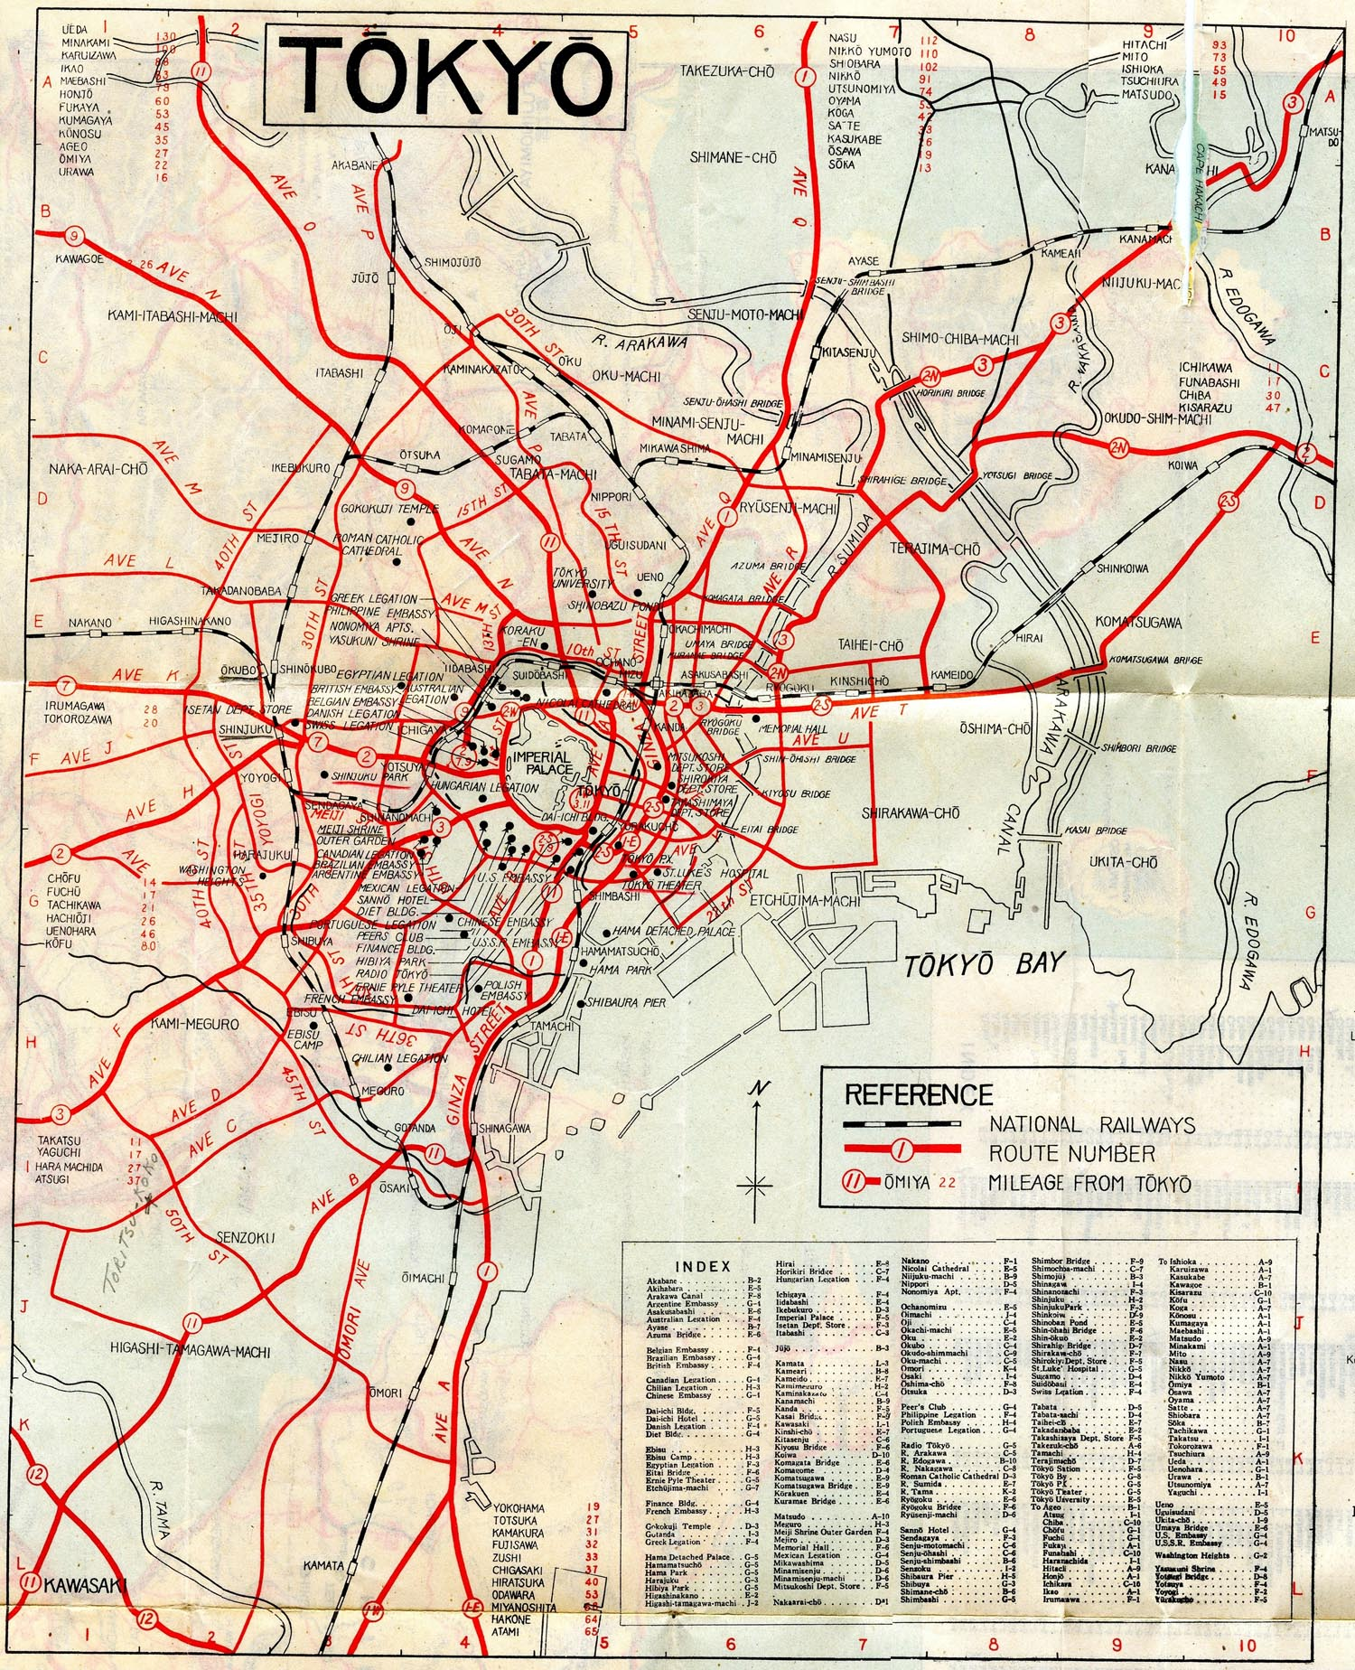
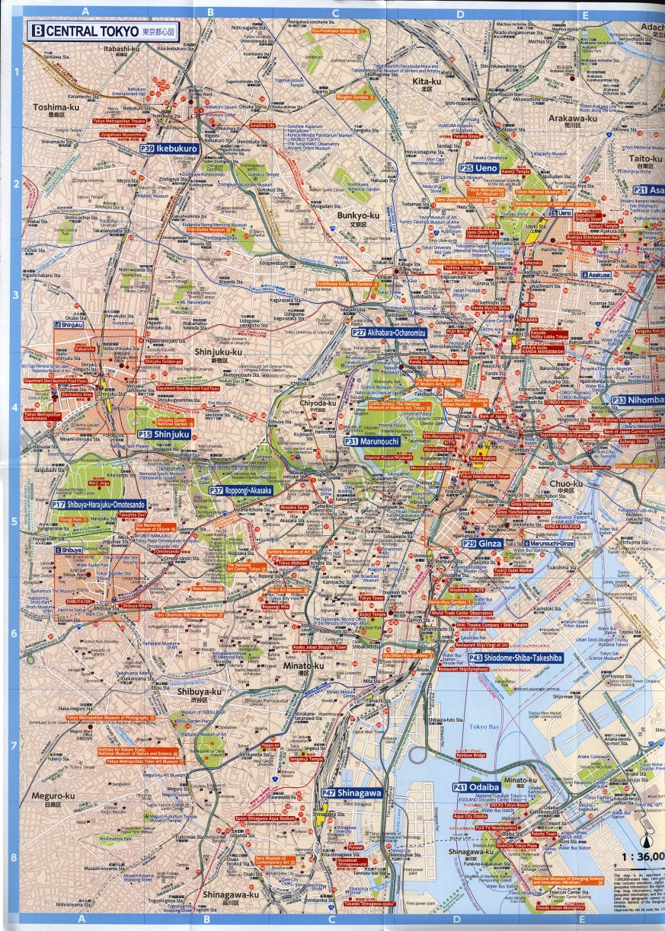
Printed Map
Topographic Map
Traveling Map
Road or Highway map
Atlas or Book

Slide 8
Advantage of Printed Map
Trusted of Publication
Such as Year, Edition
Lower Distortion or Error
Such as Color, Scale

Slide 9
Advantage of Printed Map
Easily use in every place
Comfortable for field work
Do not require
Batteries
Satellites signal while using the map
Mobile phone signal

Slide 10
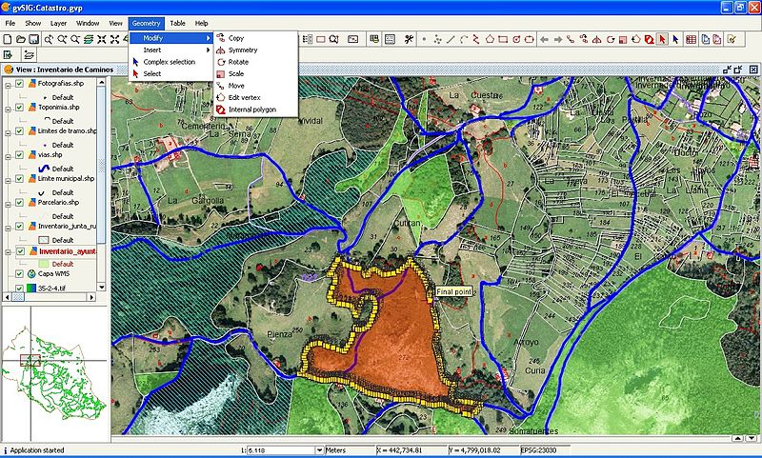
Advantage of Printed Map
Some kind of map can use in the dark by IR.
Can editing or writing new information easily.

Slide 11
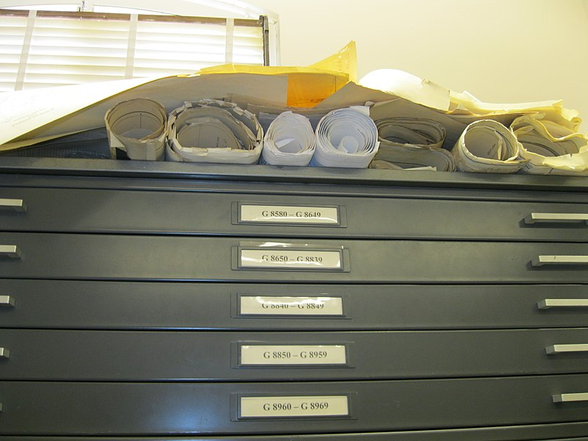
Disadvantage of Printed Map
Storage Problems
Need a place to keeping
Many map >> Many weight
Beware of humidity

Slide 12
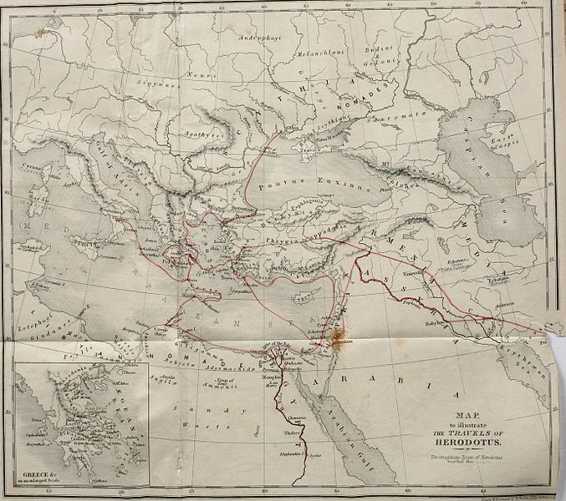
Disadvantage of Printed Map
Usage Problems
Easily torn, wet or burnt.
Size of the map is the obstacle for using.
Folding a map leading it to be torn.

Slide 13
Disadvantage of Printed Map
Editing Problems
Edited data can be shown in those map only, not in every map.
Copying a map may making many type of distortion to the new map.
Color, Scale, Size, Direction

Slide 14
Digital Map
Widely use in everyday life.
People are using the Map in mobile phone platform most.

Slide 15
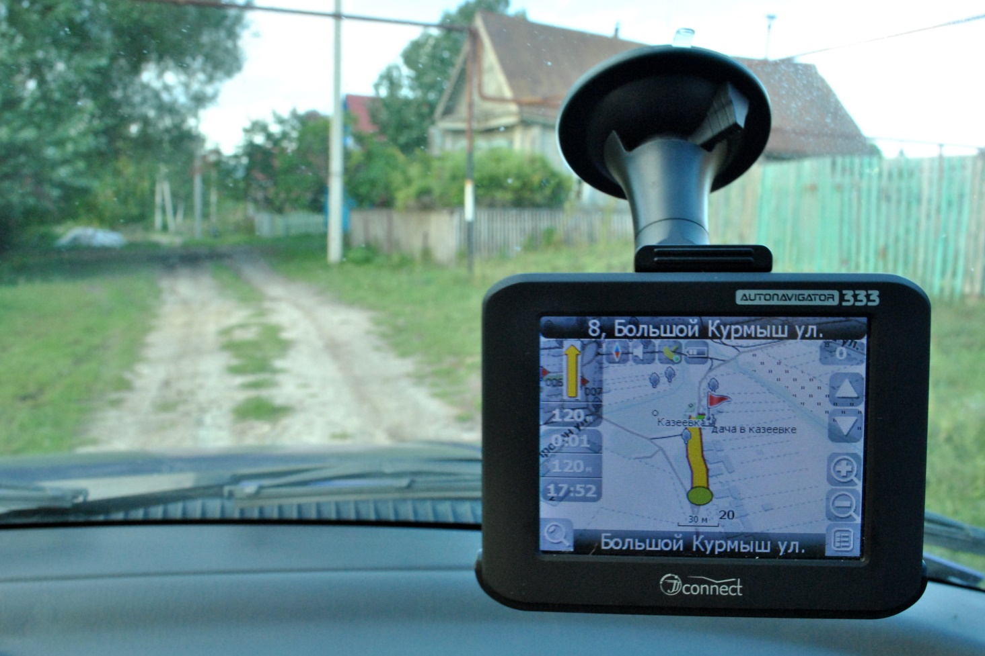
Where we can find “Digital Map”
News; Television or Social Media.
Documentary
Online map; Google map
GPS Navigator
Etc.

Slide 16
Advantage of Digital Map
Everybody can access to the map without limitation.
Mostly up-to-date data.
Do not require physical storage to keep the maps.

Slide 17
Advantage of Digital Map
Easily re-producing the map without distortion.
Users can select only layer or data that related to their work.

Slide 18
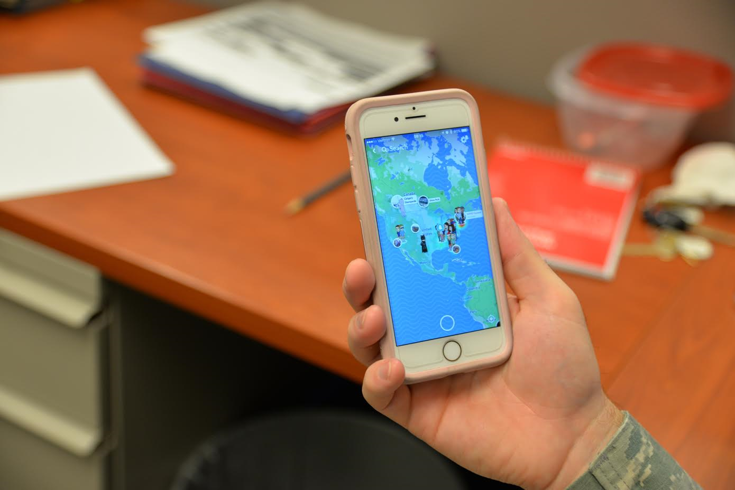
Advantage of Digital Map
Multi-scale map,
Can Zoom-in and Zoom-out
Showing the location of the user on the map.

Slide 19
Disadvantage of Digital Map
Require
IT skills to use
Batteries
Satellite signal
Mobile phone signal
Not everyone can update new spatial data to the map.

Slide 20
Map dividing from details
Planimetric map
Topographic map
Photo map

Slide 21
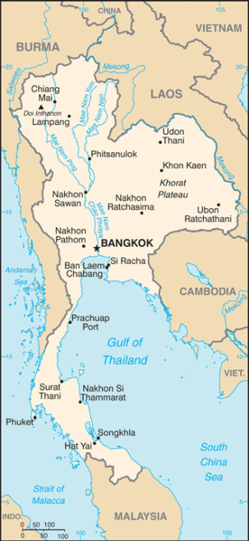
Planimetric map
Showing data in horizontal or plain only
Use for locating the location
Calculating distance or direction
Ex. Road map, Provincial map

Slide 22
Topographic map
Showing data including the height of earth’s surface
Showing horizontal and vertical data
The other details are as same as planimatic map
Height data showing by contour line.
Usually use in large scale map.

Slide 23
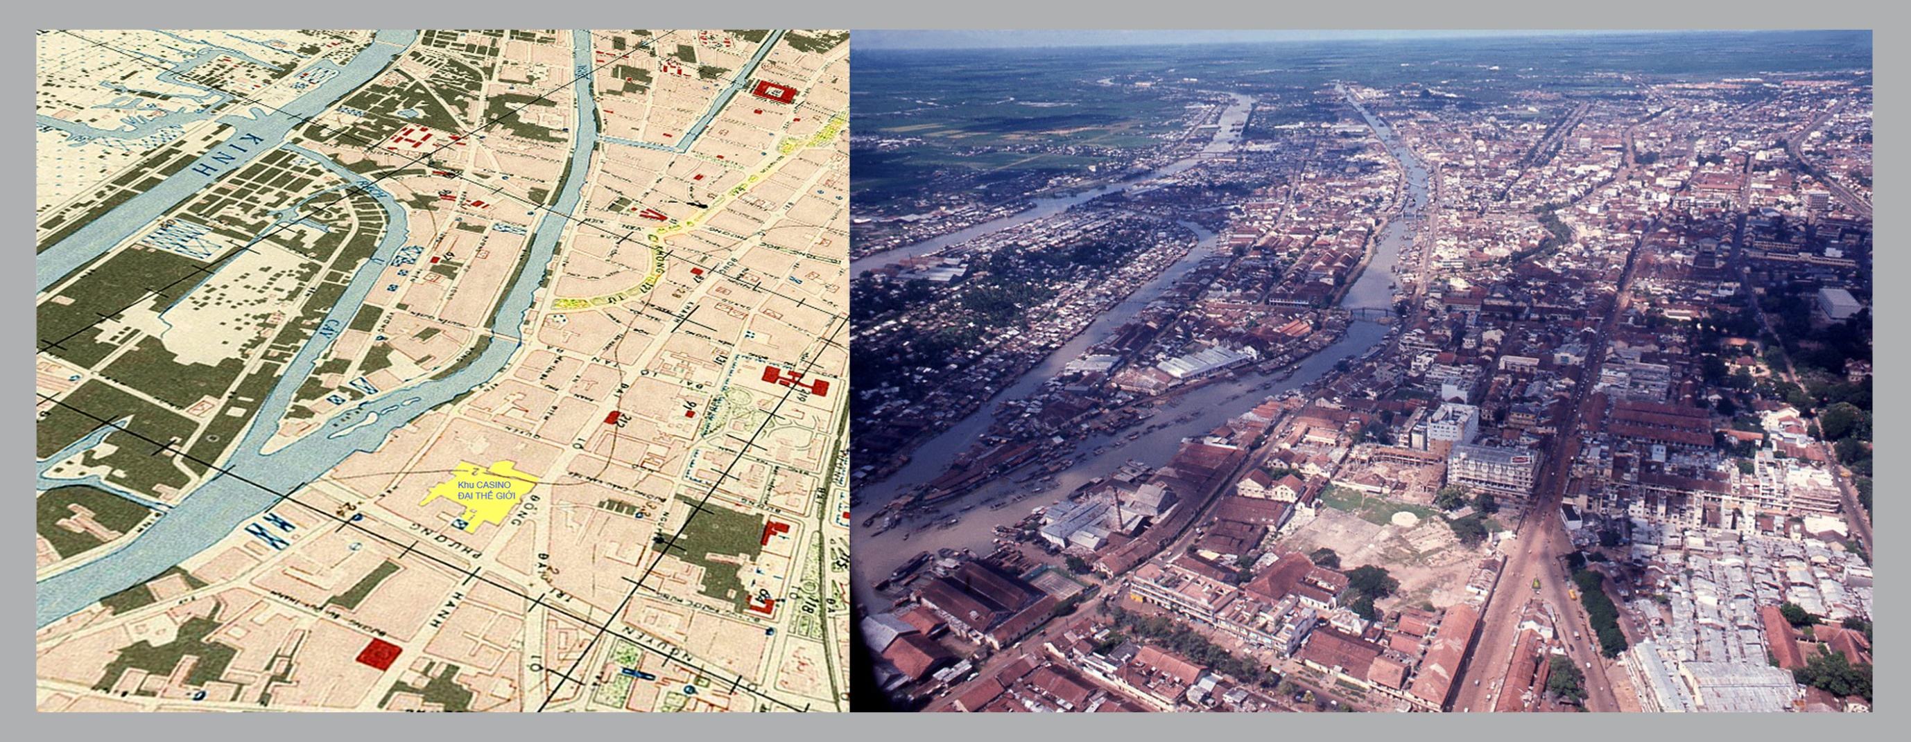
Photo map
Showing all data that stand on earth’s surface
Can not choose only considerable data
Making from aerial photo or satellite image data
Can make the up to date map in the short time
Can illustrate in 3d

Slide 24
Figure Reference
https://upload.wikimedia.org/wikipedia/commons/a/aa/USE-IT_Copenhagen_paper_map.jpg
https://www.maxpixel.net/static/photo/1x/Navigation-Maps-Media-Photo-Lg-Location-Smartphone-2198559.jpg
https://upload.wikimedia.org/wikipedia/commons/c/c7/Mount_Marcy_New_York_USGS_topo_map_1979.JPG
https://www.flickr.com/photos/worldtravellib/15131788170
https://www.flickr.com/photos/tigerzombie/6562917253
https://www.maxpixel.net/photo-2572025
https://commons.wikimedia.org/wiki/File:GvSIG_-_GIS.jpg
https://commons.wikimedia.org/wiki/File:MapGeography_19_(8711742655).jpg
https://commons.wikimedia.org/wiki/File:The_life_and_travels_of_Herodotus_in_the_fifth_century_-_before_Christ-_an_imaginary_biography_founded_on_fact,_illustrative_of_the_history,_manners,_religion,_literature,_arts,_and_social_condition_(14784344305).jpg
https://media.defense.gov/2017/Jul/14/2001778291/-1/-1/0/170712-F-JK014-1001.PNG
https://th.wikipedia.org/wiki/%E0%B9%84%E0%B8%9F%E0%B8%A5%E0%B9%8C:Thailand_map_CIA.png
https://upload.wikimedia.org/wikipedia/commons/6/60/Earth_from_Space.jpg

