Slide 1
Map and Map Interpretation 2542402
Lesson 3 : Map Components
Jittrapon Soontorn
Social Studies Program

Slide 2
Map components
Using for
Making all of the maps to be the same pattern.
Searching the maps.
Storing the maps.
Using the maps.

Slide 3
Map components
Can divide to 2 parts.
External Components
Internal Components

Slide 4
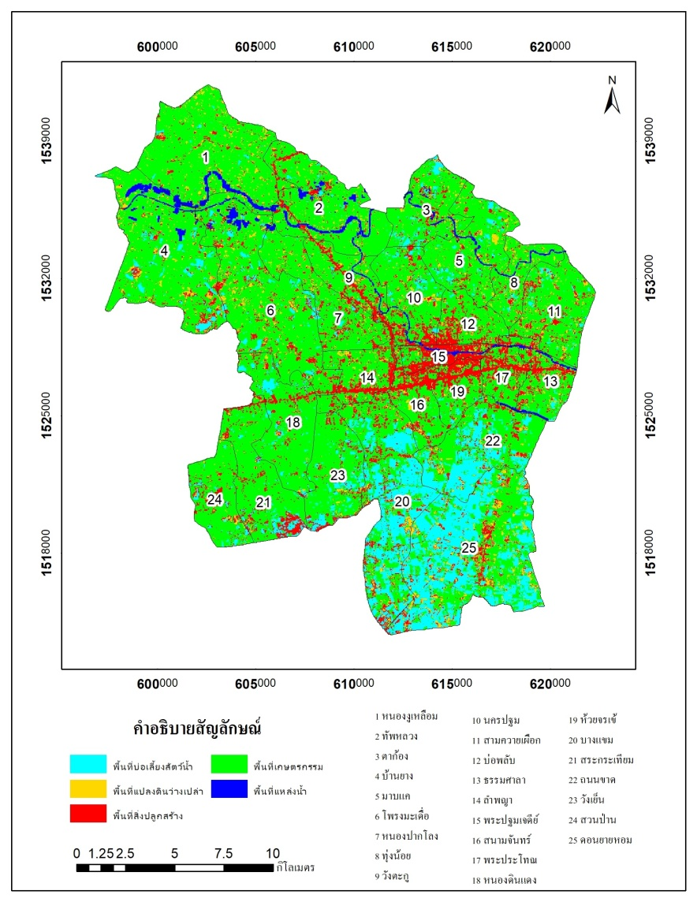
External map components
Showing at the margin of the map
May be called frame of the picture

Slide 5
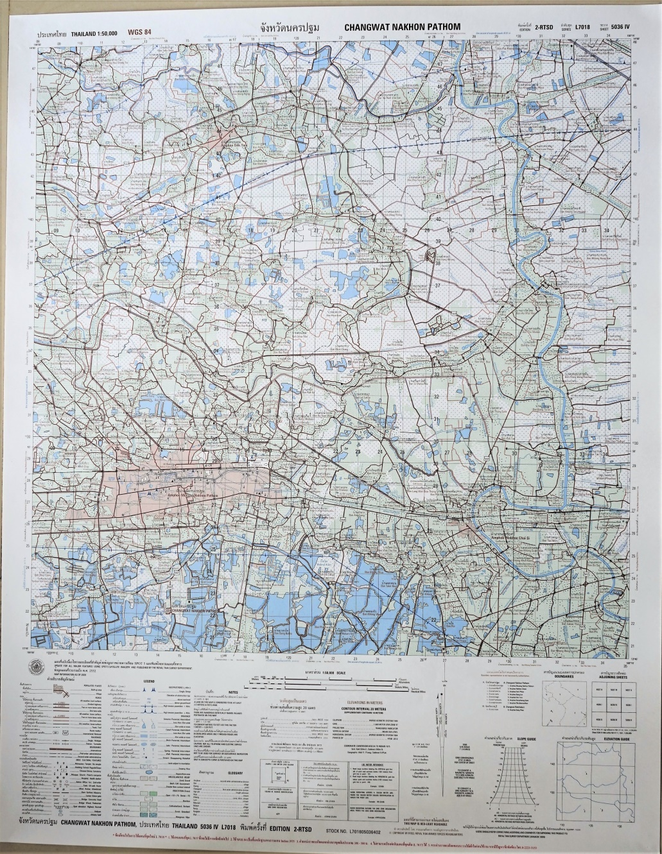
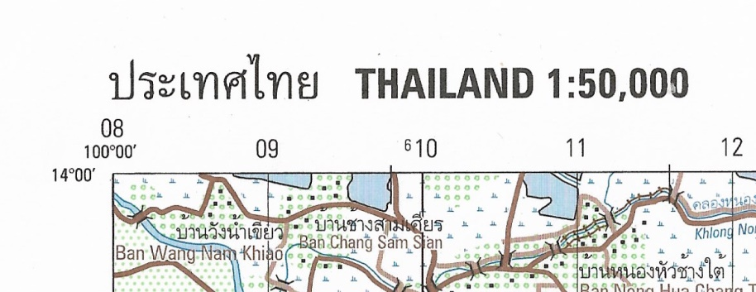
External map components
Name and Scale
Describing map name and scale of the map
Ex. L7018 are “Thailand 1: 50,000”
Showing at the left side of the top

Slide 6
External map components
Sheet name
Use as the name of each map
In the same map series, they do not use the same sheet name
Called by geographical identity of cultural in each area
Showing at the center of the top and the bottom of the map

Slide 7
External map components
Sheet number (1)
As the code of the map
Use for referencing the map
Mosaicking the map

Slide 8
External map components
Sheet number (2)
Showing at the right of the top and the left of the bottom
of the map
In L7018 map series; consist of 2 group of the number
1) 4 digit numbers
2) Roman numbers

Slide 9
External map components
Map scale
Showing at the center of the bottom of the map
2 types of map scale
1) showing as number; 1: 50,000
2) showing as ruler;

Slide 10
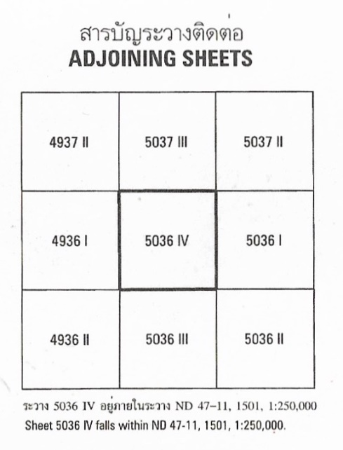
External map components
Adjoining sheets
Using for describe how to connect the maps together.
Showing as the index at the bottom of the map.

Slide 11
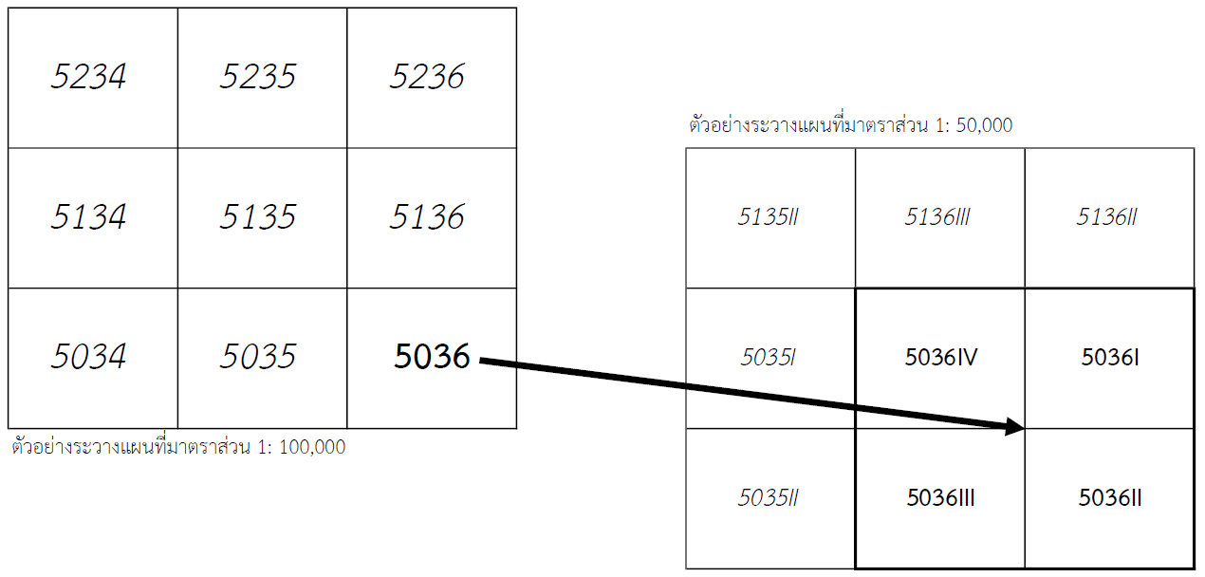
External map components
How to connect or mosaic the map
Maps in L7018 series which have the same 4 digit numbers are only 4 sheets but, different in Roman number.
Ex. 5036 I, 5036 II, 5036 III, 5036 IV
We can connect the map in clockwise direction

Slide 12
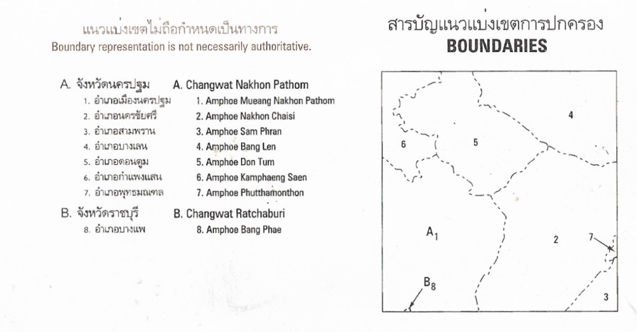
External map components
Boundaries
In the map, always show all of the spatial data in the area.
Hard to find the boundaries line that located in the map.
Boundaries index can use to define the area that included in each map.
Showing at the bottom of the map.

Slide 13
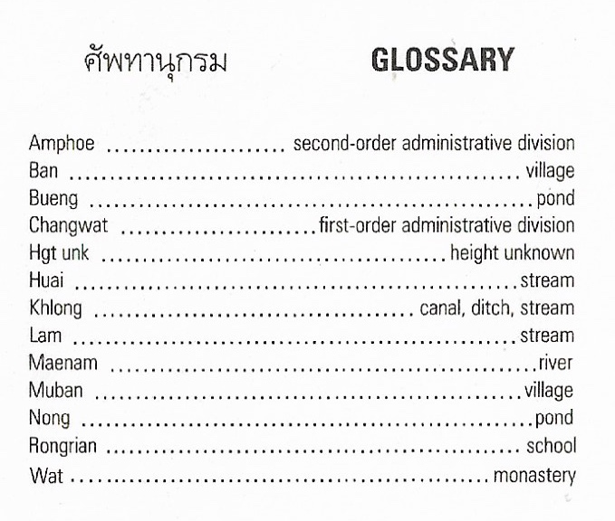
External map components
Glossary
The place that show in the map always use local name or word.
Glossary is using as dictionary to translating words
from local language to English or the others.

Slide 14
Internal map components
Symbol
Maps are describing data without using language.
Using symbol that can be understand for everyone.
At the bottom of the map always show the legend
describing the meaning of each symbol, found in the map

Slide 15
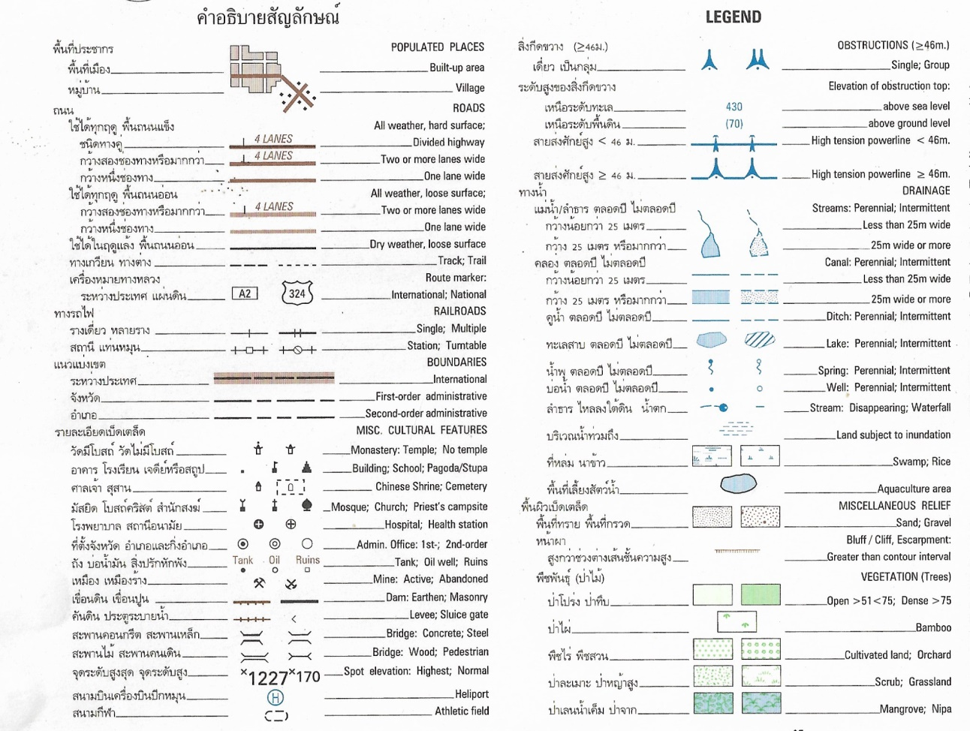
Internal map components
Symbol

Slide 16
Internal map components
Color
Is the kind of symbol.
Different color use for different meaning.
Mostly use 5 color.

Slide 17
Internal map components
Geographical name
Using the text to showing place name.
Mostly use black color font in English.
red color font in Thai.

Slide 18
Internal map components
Co-ordinate system
Showing as the grid-line for reading the co-ordinate.
In L7018 map series have 2 co-ordinate systems.
Geographical co-ordinate system.
Grid co-ordinate system.

