Slide 2
Introduction to Linguistics
Unit II: Phonetics
Ruja Sukpat
English Program
Faculty of Humanities and Social Sciences
Nakhon Pathom Rajabhat University

Slide 3
What is phonetics?

Slide 4
What is phonetics?
The science of human speech
How speech sound are transmitted
How speech sound are heard
How speech sound are produced

Slide 5
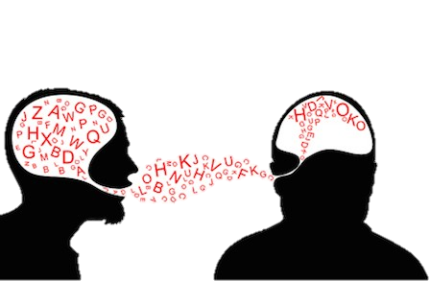
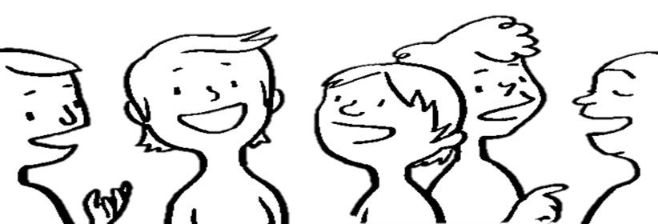
Branches of Phonetics
1. Articulatory Phonetics
2. Acoustic Phonetics
3. Auditory Phonetics

Slide 6
Speech Organs

Slide 7
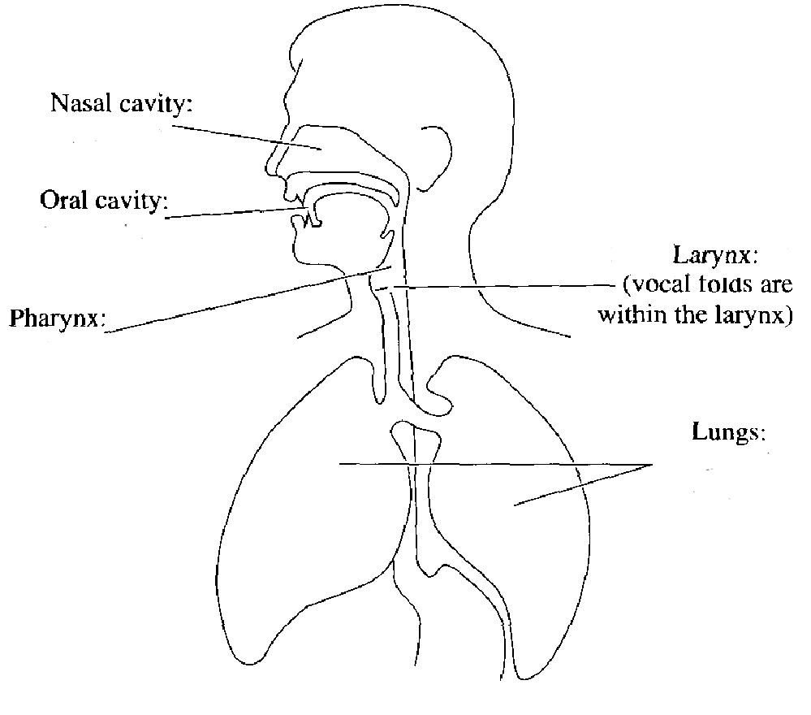
Speech Organs or Vocal Organs
articulators
larynx and vocal cords
lungs and diaphragm

Slide 8
Articulators
Articulators are organs above the larynx that are paired to produce sounds.
Passive articulators i.e. upper lip, front teeth, hard palate, alveolar ridge
Active articulators i.e. tongue, lower lip

Slide 9
Production of Speech Sounds

Slide 10
Initiation Process
Source of air used in making the sounds
Pulmonic airstream or lung air
Glottalic airstream
Velaric airstream or mouth air

Slide 11
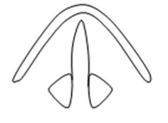
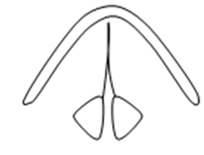
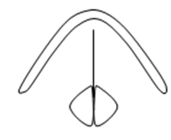
Phonation Process
Four different states of Glottis
Wide Apart
Narrow Glottis
Glottis Vibration
Tightly Close

Slide 12
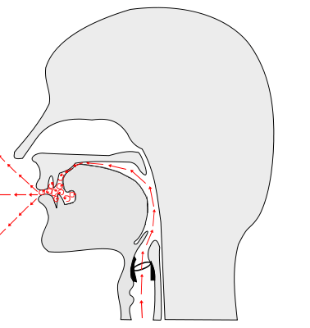
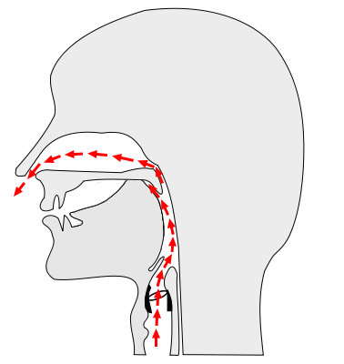
Articulation Process
The way to produce speech sounds
Oral Sound
Nasal Sound
http://www.learnlanguagesonyourown.com/manners-of-articulation.html

Slide 13
What is phoneme?

Slide 14
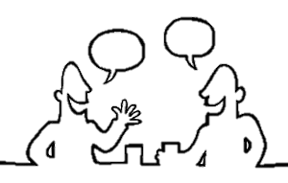
What is phoneme?
“The smallest unit of sound that makes a difference in meaning in a language”
Sumon Ariyapitipun, 2003

Slide 15
Type of Phonemes
1. Segmental Phonemes
2. Suprasegmental Phoneme
or prosodies

Slide 16
Consonant Articulation

Slide 17
Consonant Articulation
1. Source of air
2. Vocal fold states
3. Place of articulation
4. Puff of air
5. Manner of articulation

Slide 18
Source of Air
Most consonant sounds use pulmonic airstream.
All English and Thai consonant sounds use the air from lungs.

Slide 19
Vocal fold State
1. Voiceless sounds
2. Voiced sounds
http://www.learnlanguagesonyourown.com/manners-of-articulation.html

Slide 20
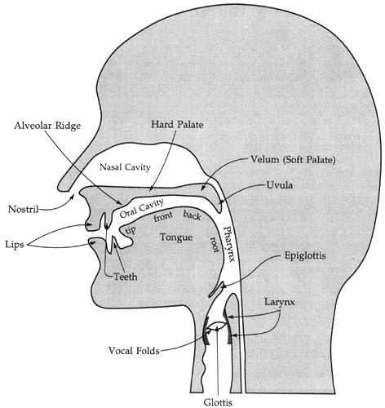
Place of Articulation
1. bilabial
2. Labiodental
3. Interdental
4. Alveolar
5. Postalveolar
6. Palatal
7. Velar
8. Glottal
(Huckvale, 2018)

Slide 21
Manners of Articulation
The manner of articulation is the configuration and interaction of the articulators when making a speech sound.
(Wikipedia, 2019)

Slide 22
Manners of Articulation (cont.)
1. Stop or plosive, a sound made with complete closure of the articulators

Slide 23
Puff of Air
Aspiration is a brief puff of air accompanying stop consonants.
Aspirated consonants
Unaspirated consonants

Slide 24
Manners of Articulation (cont.)
1. Stop or plosive, a sound made with complete closure of the articulators
2. Nasal, a sound produced with the airflow escaping through the nasal passage
3. Fricative, a sound produced when the articulator partially block the airflow

Slide 25
Manners of Articulation (cont.)
4. Affricate, a sound made by combination of stop and fricative manners at the same place of articulation
5. Lateral, a sound produced with the airflow passes to the sides of the tongue
6. Trill, similar to tap, a sound produced with a series of repeated bursts at the place of articulation

Slide 26
Manners of Articulation (cont.)
7. Tap or Flap, a sound produced with a single brief burst at the place of articulation
8. Approximant, a consonant sound similar to vowel pronunciation, a sound made by the airflow smoothly go through the articulators

Slide 27
Vowel Articulation

Slide 28
Vowel Articulation
1. Tongue Position
2. Tongue Height
3. Lip Shape
4. Degree of Length
5. Position of the Velic

Slide 29
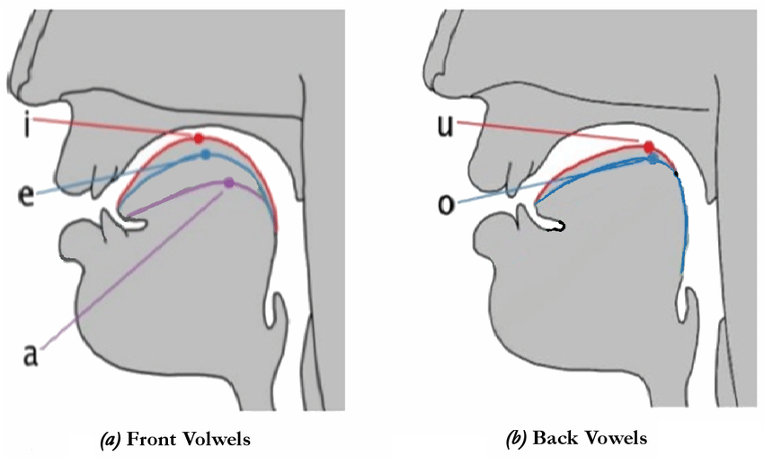
Tongue Position
Vowels different in tongue positions
1. Front Vowels
2. Central Vowels
3. Back Vowels
https://www.researchgate.net/figure/Tongue-position-for-front-and-back-vowels_fig1_319867916

Slide 30
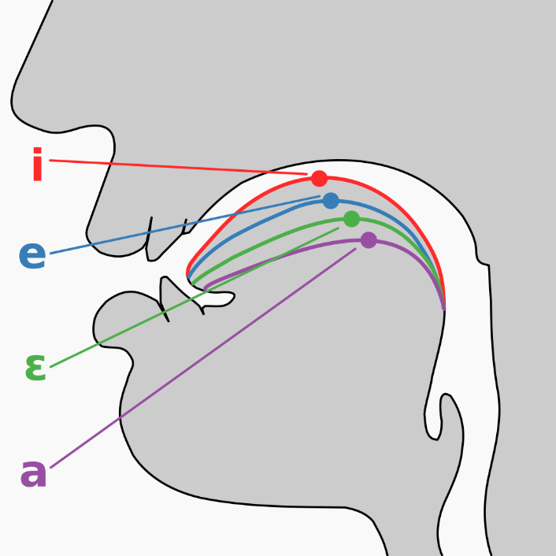
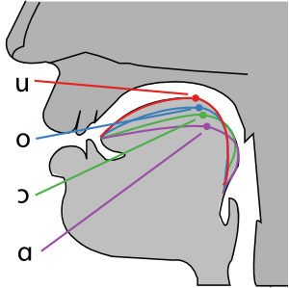
Tongue Height
Vowels different in tongue height
1. High Vowel Or Close Vowel
2. Close-mid Vowel
3. Open-mid Vowel
4. Open Vowel
https://commons.wikimedia.org/wiki/File:Cardinal_vowel_tongue_position-front.svg

Slide 31
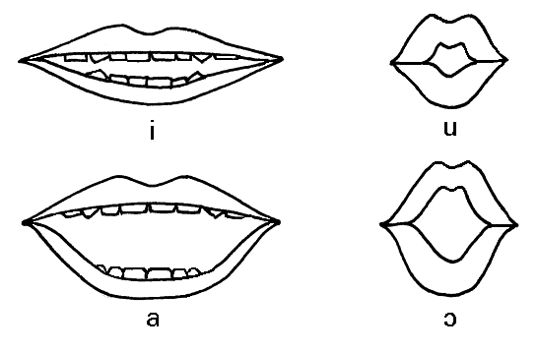
Lip Position
Vowels different in lip position
Rounded Vowels
Unrounded Vowels
http://consonantsoundsjona.blogspot.com/

Slide 32
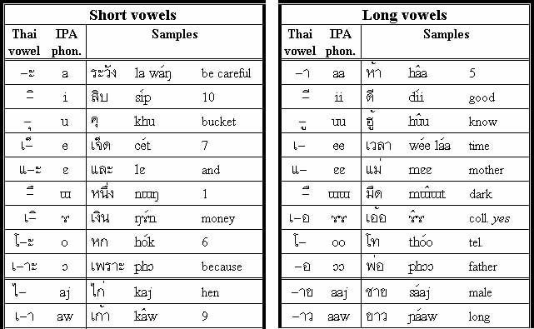
Degree of Length
Vowel length is the perceived duration of a vowel sound.
Example of Thai vowels
http://www.learnlanguagesonyourown.com/manners-of-articulation.html

Slide 33
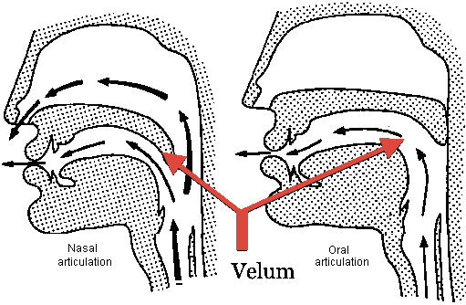
Position of the Velic
Vowel length is the perceived duration of a vowel sound.
Nasalized Vowels
Oral Vowels
https://www.mimicmethod.com/french-pronunciation-ultimate-guide/

Slide 34
Prosody or
Suprasegmental Features

Slide 35
Examples of Prosody
Stress
intensity given to a syllable of speech by special effort in utterance
Rhythm
speech movement marked by the stress, timing, and quantity of syllables.
Tone
a variation in the pitch of the voice while speaking
Pause
a break in speaking
Intonation
the melodic pattern of an utterance
Linking
the merging of sounds between words

Slide 36
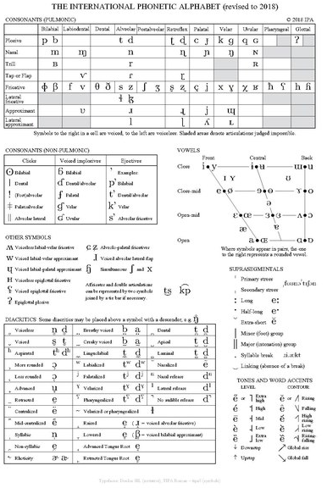
Phonetic Symbol
1 symbol represents 1 sound
Combination of Roman and Greek alphabets, including didactics
The famous phonetics symbol is International Phonetic Alphabet (IPA) of International Phonetic Association

Slide 37
Unit 2 Phonetics
Speech Organs
Speech Production
Consonant Articulation
Vowel Articulation
Suprasegmental Features

Slide 38
Thanks for your attention

