Slide 1


Slide 2





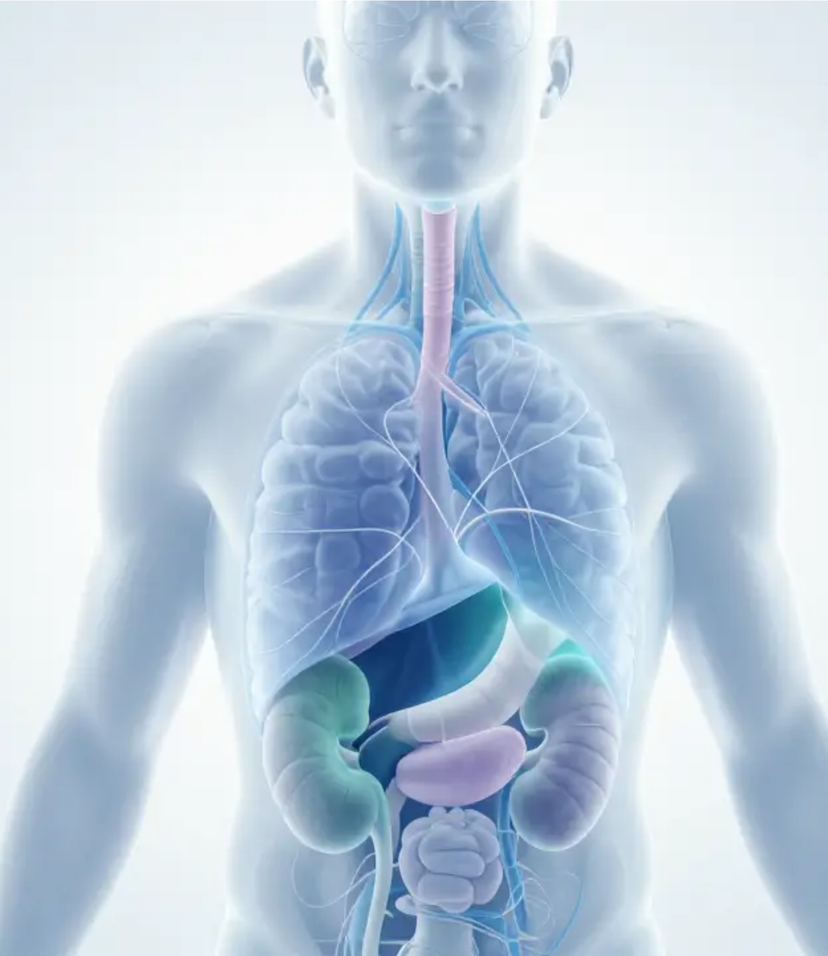
Fluid,Electrolyte &
Acid-Base Balance
Foundational Principles of Homeostasis and Clinical Pathophysiology
Asst.Prof. Jutatip Tepsuwan
Faculty of Nursing, NPRU

Slide 3



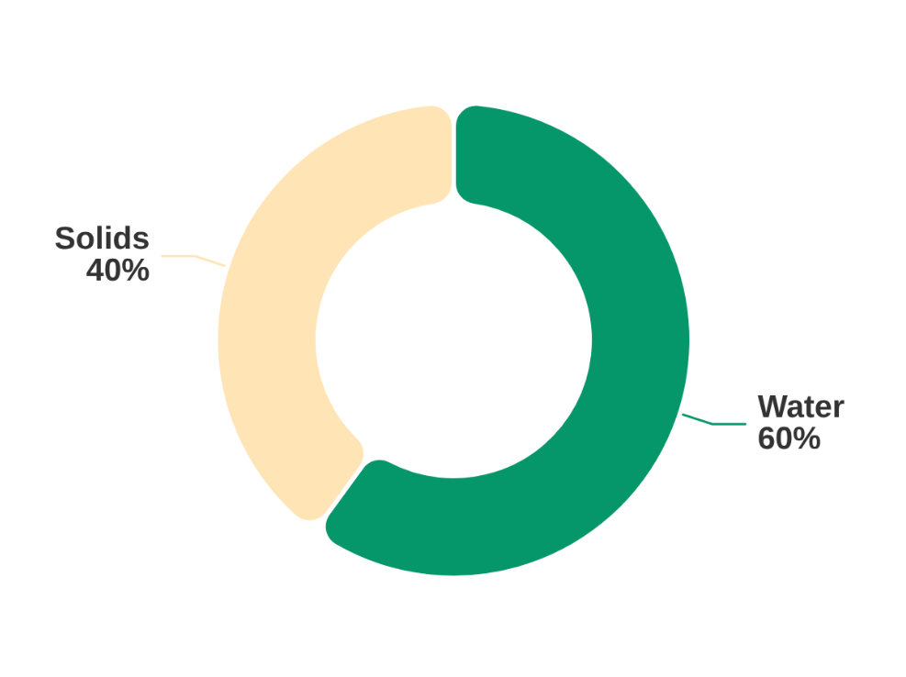














Homeostasis & Fluid Balance: The Foundation
Understanding the Body's Internal Equilibrium
What is Homeostasis?
Adult Body Composition
Homeostasis is the body's ability to maintain a delicate equilibrium of water, electrolytes, and hormones despite external changes.
Supports cellular function and organ integrity.
Regulates nutrient delivery and waste removal.
Maintains osmotic balance across membranes.
Cellular Importance
Total Body Water (TBW) accounts for approximately 60% of weight.
Every cell relies on a specific concentration of ions (electrolytes) and water to:
Clinical Implications
Nerve Conduction
Muscle Contraction
Disruptions can lead to life-threatening conditions. Nurses are the first line of defense in:
Enzyme Activity
ATP Production
1
Recognizing early signs of imbalance.
2
Interpreting diagnostic/lab data.
Faculty of Nursing, NPRU
3
Implementing timely interventions.

Slide 4

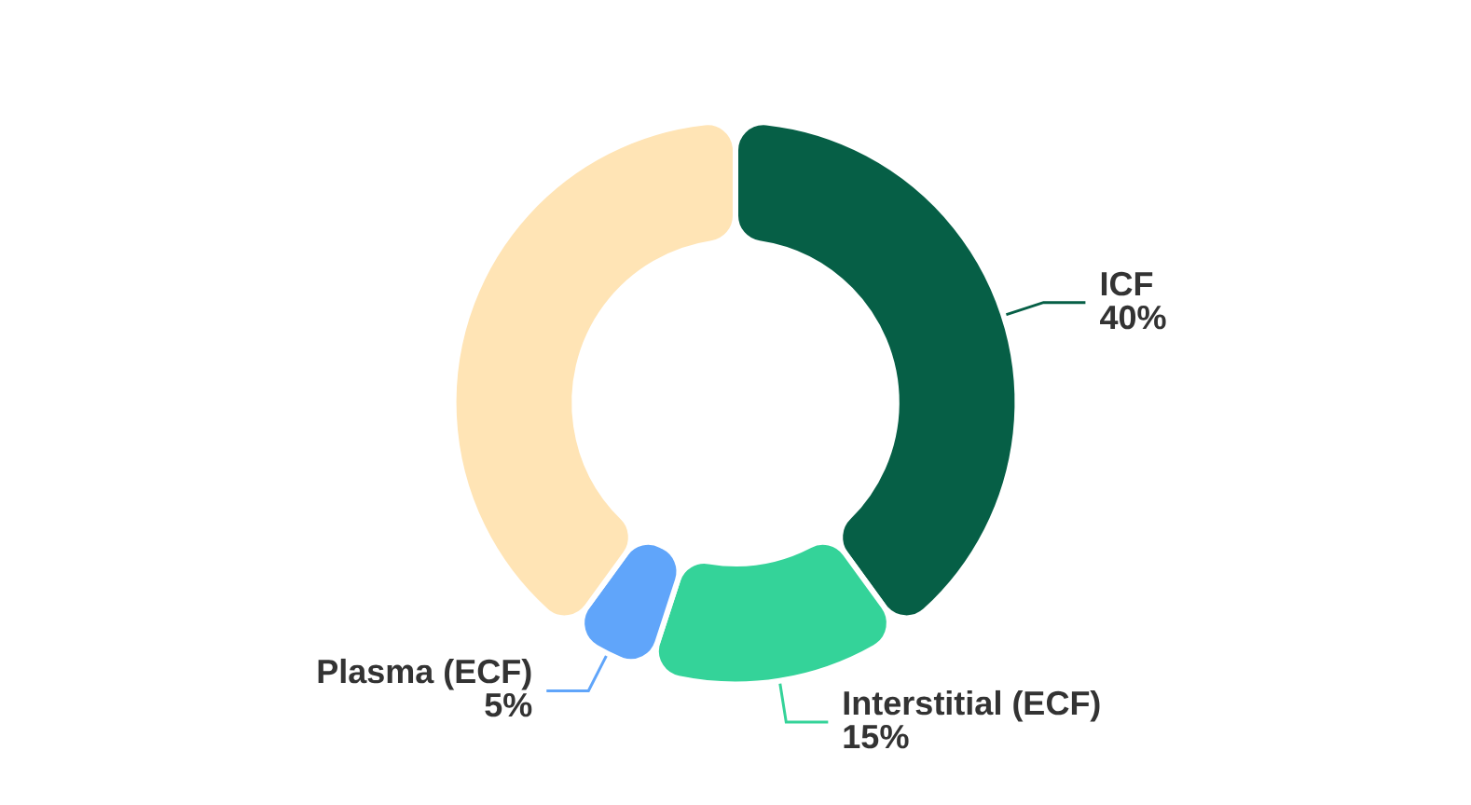














Body Fluid Compartments
Distribution: Intracellular vs. Extracellular Fluid
SECTION 1: THE FOUNDATION
Total Body Water (TBW)
Fluid Distribution Ratio
Adults are approximately 60% water by weight. For a 70kg adult, this equals ~42 Liters.
ICF (INTRACELLULAR)
ECF (EXTRACELLULAR)
40%
20%
~28 Liters
~14 Liters
ICF Composition
ECF Composition
Potassium (K+) - Primary
Sodium (Na+) - Primary
ECF Breakdown:
Magnesium (Mg2+)
Chloride (Cl⁻)
Interstitial Fluid: 15% (~10.5L)
Phosphate (HPO4²⁻)
Bicarbonate (HCO3⁻)
Plasma: 5% (~3.5L)
Faculty of Nursing, NPRU
Pathophysiology of Endocrine Disorders - Fluid & Electrolyte Balance

Slide 5


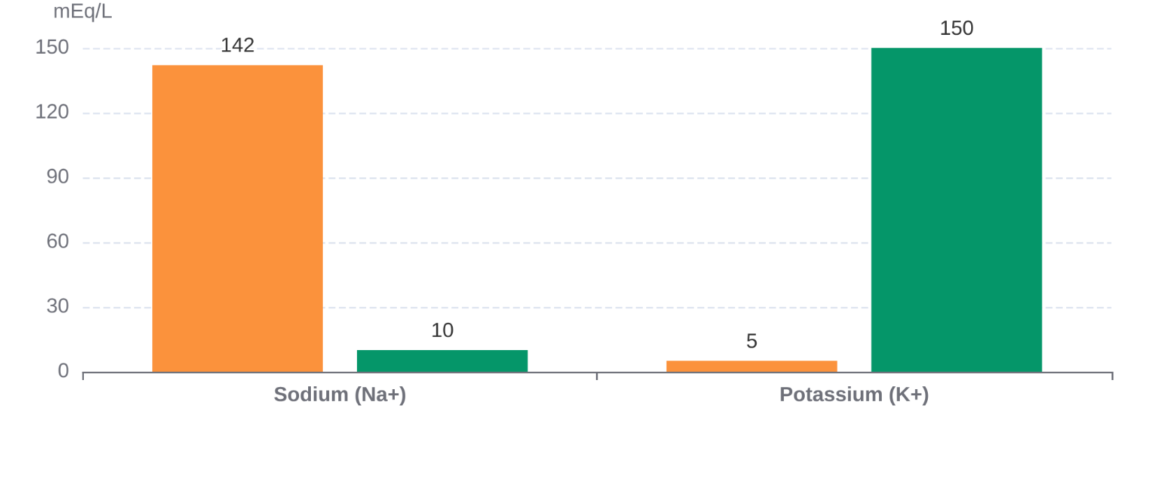














Electrolyte Composition: ICF vs. ECF
Distinct ionic distribution maintains cellular potential and osmotic balance.
Primary Cation Gradients (mEq/L)
INTRACELLULAR FLUID (ICF)
Dominated by Potassium (K+), Magnesium, and Phosphate.
EXTRACELLULAR FLUID (ECF)
Dominated by Sodium (Na+), Chloride, and Bicarbonate.
The Na+/K+ ATPase Pump actively maintains these
gradients by moving 3 Na+ out and 2 K+ in.
Na⁺
K⁺
Ca²⁺
Cl⁻
ROLE
ROLE
ROLE
ROLE
Resting membrane
potential & cellular
excitability.
Neuromuscular
transmission & blood
coagulation.
Most abundant ECF
anion; maintains
electrical neutrality.
Maintains osmotic
pressure and fluid
volume.
Faculty of Nursing, NPRU
Fluid, Electrolyte & Acid-Base Balance

Slide 6












Fluid Movement Mechanisms
Osmosis
Diffusion
Active Transport
Passive movement of water across a semipermeable membrane from low solute to high solute concentration.
Passive movement of solutes from an area of higher concentration to lower concentration.
Movement of substances against their concentration gradient. Requires energy in the form of ATP.
KEY FEATURE
CLINICAL EXAMPLE
VITAL PROCESS
Driven by osmotic pressure; Equalizes concentrations.
Gas exchange (O₂ and CO₂) in the lungs and tissues.
Na⁺/K⁺ ATPase pump
(3 Na⁺ out / 2 K⁺ in).
Mechanism
What Moves?
Direction
Energy Needed?
Osmosis
Water (Solvent)
Low to High Solute
No (Passive)
Diffusion
Solutes (Ions/Gas)
High to Low Solute
No (Passive)
Faculty of Nursing, NPRU
Active Transport
Ions / Glucose
Against Gradient
Yes (ATP)

Slide 7



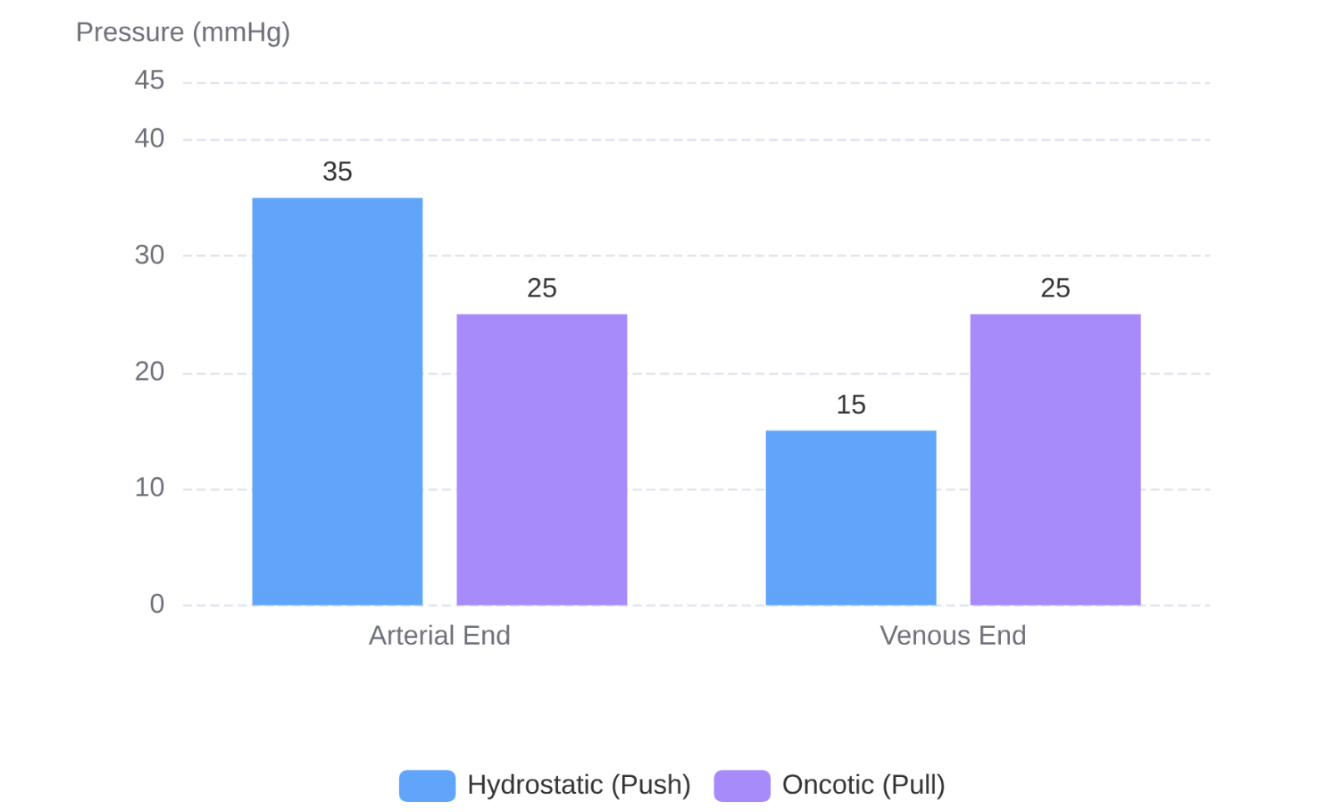









Starling's Law: Capillary Fluid Exchange
The balance between Hydrostatic and Oncotic pressures
Hydrostatic Pressure (Ph)
Pressure Gradient Comparison
The "Pushing Force" generated by the heart. Drives fluid out of capillaries into the interstitial space.
Arterial End: ~35 mmHg
Venous End: ~15 mmHg
Oncotic Pressure (Po)
The "Pulling Force" created by plasma proteins (Albumin). Pulls fluid back into the capillary lumen.
Constant: ~25 mmHg throughout the capillary
Pathophysiology of Edema
↑ Hydrostatic Pressure
↓ Plasma Oncotic Pressure
Net Result:
Arterial: Net Filtration (Out)
↑ Capillary Permeability
Lymphatic Obstruction
Venous: Net Reabsorption (In)
Faculty of Nursing, NPRU

Slide 8
















Regulatory Organs
The Three Pillars of Homeostatic Control
The Kidneys
The Lungs
Endocrine System
PRIMARY REGULATORS
RAPID RESPONSE SYSTEM
CHEMICAL ORCHESTRATION
Water & Na+ Regulation:
Adjusts excretion based on
volemic status.
CO₂ Elimination: Controls the concentration of volatile acid in blood.
Hormonal Signals: Coordinates responses between distant organs.
Acid-Base Balance: Reabsorbs HCO₃⁻ and excretes H⁺ ions.
pH Control: Altering respiratory rate/depth to adjust pH levels quickly.
Volume Control: ADH and ANP regulate water reabsorption/loss.
Electrolyte Control: Precise secretion of K⁺, Ca²⁺, and Mg²⁺.
Compensation: Responds within minutes to metabolic disturbances.
Pressure Control: RAAS system manages systemic blood pressure.
Summary: These organs work in concert. A failure in one system (e.g., Kidney Failure) often requires compensation from another (e.g., Respiratory System) to maintain survival.
Faculty of Nursing, NPRU

Slide 9


















FLUID VOLUME DEFICIT (HYPOVOLEMIA)
Decreased circulating volume and impaired tissue perfusion.
Etiology
Symptoms
Compensation
GI Losses: Vomiting, diarrhea, and bleeding.
VITAL SIGNS
RENAL
RAAS Activation
Tachycardia
Oliguria
Hypotension
Stimulates aldosterone to promote sodium and water reabsorption in the kidneys.
Hemorrhage: Trauma or surgical complications.
SKIN/ORAL
NEURO
Burns: Significant fluid loss through damaged skin.
Dry Mucosa
Altered Status
ADH Release
Poor Turgor
Increases water reabsorption in collecting ducts to concentrate urine and conserve volume.
Third-spacing: Sepsis, pancreatitis, or bowel obstruction.
Note: Peripheral vasoconstriction often leads to cold, clammy extremities.
Baroreceptors
Triggers SNS response to increase Heart Rate and systemic vascular resistance.
Faculty of Nursing, NPRU

Slide 10



















Fluid Volume Excess (Hypervolemia)
Pathophysiology of Fluid Overload and Edema Formation
Primary Causes
Edema & Clinical Signs
Heart Failure
Peripheral Edema:
Pitting swelling in lower extremities.
Reduced cardiac output triggers RAAS, leading to sodium and water retention.
Pulmonary Edema:
Crackles, Dyspnea, Hypoxia.
Renal Failure
Ascites:
Fluid accumulation in the peritoneal cavity.
Decreased GFR impairs the kidneys' ability to excrete excess fluids.
Anasarca:
Severe, generalized whole-body edema.
Excessive IV Fluids
Overzealous administration of isotonic saline or dextrose solutions.
Liver Cirrhosis
Key Nursing Alert: Monitor for sudden weight gain, increased blood pressure, and respiratory distress.
Hypoalbuminemia reduces oncotic pressure, causing fluid leakage.
Faculty of Nursing, NPRU

Slide 11




















Hormonal Regulation of Fluid Balance
ADH, RAAS, and ANP Mechanisms
ADH
RAAS
ANP
THE WATER SAVER
THE VOLUME BOOSTER
THE NATURAL DIURETIC
Trigger:Increased plasma osmolarity or low blood volume.
Trigger:Decreased renal perfusion (hypovolemia/hypotension).
Trigger:Atrial stretch due to fluid overload (hypervolemia).
Source:Hypothalamus (Post. Pituitary)
Mechanism:Renin → Angiotensin II → Aldosterone
Source:Atrial cells of the heart
Action:Inserts Aquaporins in collecting ducts. Reabsorbs pure water.
Action:Na+ and H2O retention in distal tubules; vasoconstriction.
Action:Excretes Na+ and H2O; inhibits ADH and Aldosterone.
Results in concentrated urine
Increases blood pressure & volume
Reduces fluid overload
ADH: Water Balance
RAAS: Pressure/Volume
ANP: Overload Relief
Faculty of Nursing, NPRU

Slide 12














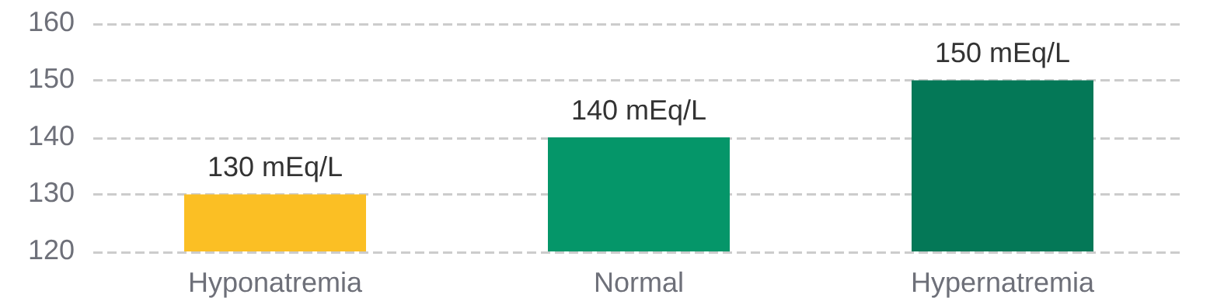



Sodium Imbalance (Na⁺)
The Primary Extracellular Cation & Fluid Regulator
NORMAL RANGE: 135 – 145 MEQ/L
Hyponatremia (< 135)
Hypernatremia (> 145)
PRIMARY CAUSES
PRIMARY CAUSES
SIADH (Water retention)
Heart Failure
Dehydration / Low Water
Diabetes Insipidus
Cirrhosis
Diuretic Use
Excessive Na⁺ Intake
Severe Diarrhea
Neurological Impact
Osmotic Impact
Water moves INTO cells → Swelling
Water moves OUT of cells → Shrinkage
Cerebral Edema
Confusion/Headache
Cellular Dehydration
Intense Thirst
Seizures/Coma
Lethargy
Irritability
Flushed Skin
NURSING MANAGEMENT
Fluid Restriction Prevents further dilution.
Hypertonic Saline 3% NaCl (caution: correct slowly).
Faculty of Nursing, NPRU
Na⁺ Balance

Slide 13








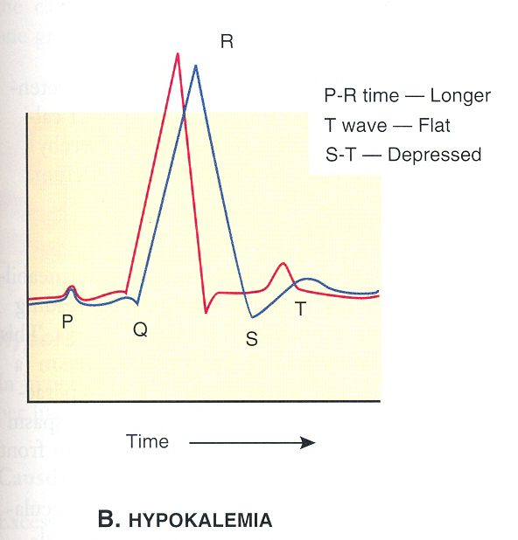




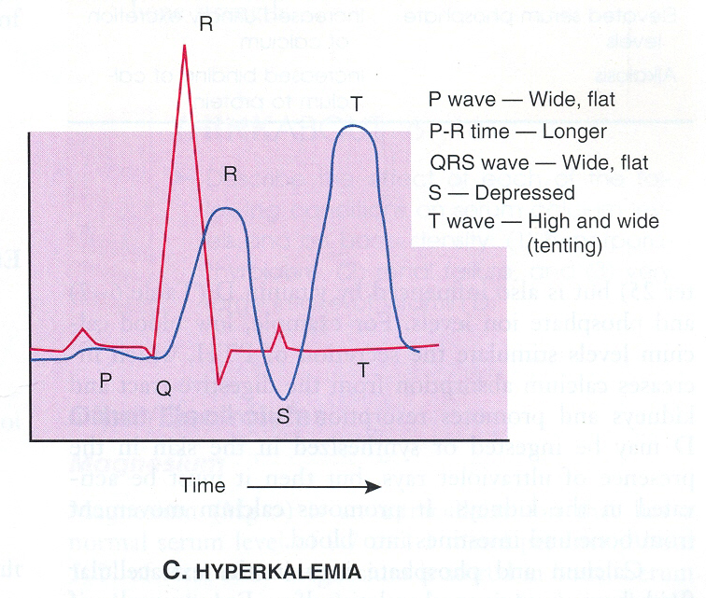


NORMAL SERUM RANGE
Potassium Imbalance (K)
3.5 – 5.0 mEq/L
The Primary Intracellular Cation & Cardiac Regulator
Low K
Hypokalemia
High K
Hyperkalemia
< 3.5 mEq/L
> 5.0 mEq/L
Common Causes
Common Causes
Loop diuretics, GI losses (vomiting/diarrhea), Alkalosis, Insulin therapy.
Renal failure (most common), Metabolic Acidosis, Tissue injury/burns, K-sparing diuretics.
Manifestations
Manifestations
Muscle weakness, fatigue, leg cramps, constipation, decreased deep tendon reflexes.
Muscle twitching (early), paralysis (late), cardiac arrhythmias, abdominal cramping.
ECG Changes
ECG Changes (Medical Emergency)
Flattened or Inverted T waves
Tall, Peaked T waves (Tent-shaped)
Prominent U waves
Widened QRS complex
Prolonged QT interval
Flat or absent P waves
ST segment depression
Progression to Ventricular Fibrillation
Critical Nursing Safety Alert
NEVER administer Potassium via IV push or bolus. It must be diluted and infused slowly (max 10-20 mEq/hr) via infusion pump to avoid immediate cardiac arrest.
Faculty of Nursing, NPRU

Slide 14





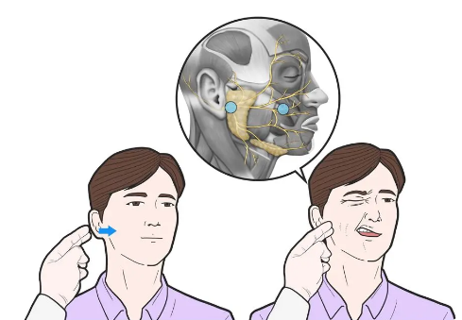










Calcium Imbalance (Ca²⁺)
NORMAL RANGE
REGULATING NEUROMUSCULAR EXCITABILITY
8.5 – 10.5 mg/dL
Hypocalcemia (< 8.5 mg/dL)
Hypercalcemia (> 10.5 mg/dL)
"Increased Neuromuscular Irritability"
"Decreased Neuromuscular Irritability"
Key Clinical Signs
PRIMARY ETIOLOGY
Chvostek’s Sign: Facial twitching upon tapping.
Primary Hyperparathyroidism:Most common cause.
Trousseau’s Sign: Carpopedal spasm with BP cuff.
Malignancy:Bone metastases or paraneoplastic syndromes.
COMMON CAUSES
SYSTEMIC MANIFESTATIONS
Hypoparathyroidism, Vitamin D deficiency, Acute pancreatitis, Magnesium deficiency.
Renal Stones
Confusion
Lethargy
Arrhythmias
SYMPTOMS
OTHER CAUSES
Tetany, muscle cramps, paresthesias, prolonged QT interval, seizures.
Vitamin D intoxication, Thiazide diuretics, Immobilization.
Faculty of Nursing, NPRU
ELECTROLYTE IMBALANCES: CALCIUM
Regulated by PTH, Calcitonin, & Vitamin D

Slide 15










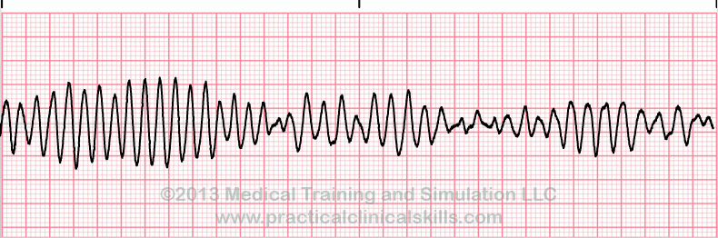




MAGNESIUM & PHOSPHORUS
Magnesium (Mg²⁺)
Phosphorus (PO₄³⁻)
Normal Range: 1.7 – 2.6 mg/dL
Normal Range: 2.5 – 4.5 mg/dL
Key Physiological Roles
Key Physiological Roles
Cofactor for 300+ enzymatic reactions: Energy production (ATP), protein synthesis, and neuromuscular stability.
Critical component of ATP, DNA/RNA, and cell membranes. Essential for bone mineralization and acid-base balance.
HYPOMAGNESEMIA (<1.7)
HYPERMAGNESEMIA (>2.6)
HYPOPHOSPHATEMIA (<2.5)
HYPERPHOSPHATEMIA (>4.5)
Alcoholism, Diuretics
Renal Failure
Refeeding Syndrome, DKA
Renal Failure, Tumor Lysis
Muscle cramps, Tremors
Muscle Weakness
Rhabdomyolysis
Soft Tissue Calcification
Cardiac Arrhythmias
Bradycardia / Hypotension
Respiratory Failure
Secondary Hypocalcemia
Torsades de Pointes
Clinical Monitoring & Nursing Priorities
Routine Lab Monitoring
Dietary Management
Close IV Monitoring
Essential for high-risk patients (Critical Care, Malnutrition, Chronic Renal Disease)
Faculty of Nursing, NPRU

Slide 16














INTRODUCTION TO PH & BUFFER SYSTEMS
Maintaining Acid-Base Homeostasis
NORMAL PHYSIOLOGICAL RANGE
7.35 — 7.45
Acidosis
Alkalosis
Deviations impair enzymes, disrupt metabolism, and can be life-threatening.
Chemical Buffers
Elimination of CO₂ through
ventilation adjustments.
Respiratory System
Renal System
Regulates H⁺ excretion and
HCO₃⁻ reabsorption.
1st Line of Defense. Immediate
neutralization of acids or bases.
INSTANT RESPONSE
MINUTES TO HOURS
HOURS TO DAYS
Buffer System
Primary Location
Key Components
Bicarbonate
Extracellular Fluid (ECF)
HCO₃⁻ / H₂CO₃ (Most significant in blood)
Phosphate
Intracellular Fluid (ICF) / Renal
HPO₄²⁻ / H₂PO₄⁻ (Effective in urine)
Protein
Intracellular Fluid / Plasma
Amino acids, Hemoglobin (Binds H⁺)
Faculty of Nursing, NPRU

Slide 17
















RESPIRATORY & RENAL REGULATION
Secondary and Tertiary Lines of Defense in Acid-Base Balance
Respiratory Regulation
Renal Regulation
RAPID RESPONSE (MINUTES)
LONG-TERM RESPONSE (HOURS/DAYS)
Controls pH by adjusting CO₂ elimination:
Adjusts HCO₃⁻ and H⁺ levels:
In Acidosis: Excretes H⁺ and reabsorbs/generates
new HCO₃⁻.
In Acidosis: Hyperventilation (blows off CO₂) to
increase pH.
In Alkalosis: Hypoventilation (retains CO₂) to
decrease pH.
In Alkalosis: Reduces H⁺ excretion and increases
HCO₃⁻ excretion.
RESPIRATORY CONTROL
INTERMEDIATE
RENAL CONTROL
CO₂ + H₂O
H₂CO₃
H⁺ + HCO₃⁻
Faculty of Nursing, NPRU

Slide 18








Types of Acid-Base Imbalance
Classification by Primary Disturbance and Systemic Origin
Respiratory Acidosis
pH ↓
Respiratory Alkalosis
pH ↑
pCO₂ ↑
pCO₂ ↓
COMMON CAUSES:
COMMON CAUSES:
Hypoventilation (Respiratory failure)
Hyperventilation (Anxiety, Panic)
COPD / Chronic Lung Disease
Acute Hypoxia (High altitude)
Drug Overdose (Opioids, Sedatives)
Fever / Sepsis
Chest wall trauma / Neuromuscular weakness
Salicylate overdose (early stage)
Renal Compensation: Kidneys retain HCO₃⁻ and excrete H⁺ (takes 24-48 hours).
Renal Compensation: Kidneys increase HCO₃⁻ excretion.
Metabolic Acidosis
pH ↓
Metabolic Alkalosis
pH ↑
HCO₃⁻ ↓
HCO₃⁻ ↑
COMMON CAUSES:
COMMON CAUSES:
Diabetic Ketoacidosis (DKA)
Prolonged Vomiting / NG Suction (Loss of HCl)
Lactic Acidosis (Shock, Sepsis)
Excessive Diuretic use (Loop/Thiazide)
Severe Diarrhea (Loss of Bicarbonate)
Hypokalemia
Chronic Kidney Disease (CKD)
Excessive Bicarbonate administration
Respiratory Compensation: Kussmaul respirations (Deep, rapid breathing to blow off CO₂).
Respiratory Compensation: Hypoventilation to retain CO₂ (limited by oxygen needs).
Faculty of Nursing, NPRU
Acidosis: pH < 7.35
Normal Range: pH 7.35 – 7.45 | pCO₂ 35 – 45 | HCO₃⁻ 22 – 26
Alkalosis: pH > 7.45

Slide 19














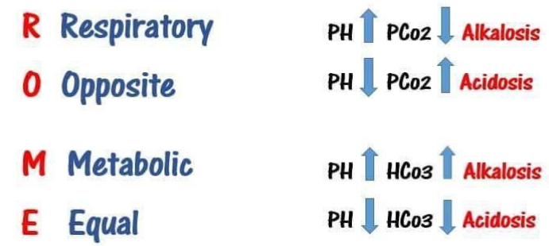









ABG Interpretation
A Step-by-Step Approach to Acid-Base Assessment
1
2
3
4
Analyze pH
Analyze pCO2
Analyze HCO3-
Compensation
7.35 – 7.45
35 – 45 mmHg
22 – 26 mEq/L
The Body's Response
< 7.35: Acidosis
RESPIRATORY COMPONENT
METABOLIC COMPONENT
Determine if the opposite system is moving in the direction to return the pH to normal limits.
> 45: Respiratory Acidosis
< 22: Metabolic Acidosis
> 7.45: Alkalosis
< 35: Respiratory Alkalosis
> 26: Metabolic Alkalosis
Example: In Metabolic Acidosis,
the lungs hyperventilate to blow
off CO2 (Step 2).
Nursing Tip: If pH and CO2 move in opposite directions, the problem is Respiratory. If they move in the same direction, it's Metabolic (ROME).
Faculty of Nursing, NPRU

Slide 20


















Compensation Mechanisms
Restoring Physiological pH Balance
CLINICAL ASSESSMENT
Degrees of Compensation
1
Uncompensated
2
3
Partially Compensated
Fully Compensated
pH:Abnormal
pH:Abnormal
pH:Normal (7.35–7.45)
Cause:Abnormal
Cause:Abnormal
Cause:Abnormal
Opposite:Normal
Opposite:Moving to Correct
Opposite:Abnormal
Respiratory System
Renal System
FAST RESPONSE (MINUTES TO HOURS)
SLOW RESPONSE (HOURS TO DAYS)
Adjusts pCO2 by changing ventilation. In metabolic acidosis, the lungs increase rate (Hyperventilation) to blow off CO2 and raise pH.
Adjusts HCO3- and H+. In respiratory acidosis, kidneys excrete H+ and reabsorb HCO3- to neutralize acidity.
Faculty of Nursing, NPRU
NURSING PATHOPHYSIOLOGY: ACID-BASE BALANCE

Slide 21




















Nursing Management
Foundations of Fluid, Electrolyte & Acid-Base Restoration
Clinical Practice
Comprehensive Assessment
Therapeutic Interventions
Safety & Monitoring
Vital Signs: Monitor for tachycardia, hypotension, or respiratory changes.
Fluid Therapy: Administer IV replacement or implement fluid restrictions (e.g., SIADH).
Neuro Status: Frequent checks to detect cerebral edema or demyelination.
Electrolyte Support: Oral or IV supplementation based on serum deficits.
ECG Monitoring: Continuous tracking for arrhythmia risk (K+ imbalances).
I/O Tracking: Precise hourly intake and output measurements.
Daily Weights: The most reliable indicator of acute fluid volume change.
Underlying Cause: Manage primary issues (e.g., vomiting, diarrhea, renal failure).
Lab Frequency: Serial Na+, K+, and ABG draws as ordered.
CRITICAL SAFETY LIMITS - NEVER PUSH IV ELECTROLYTES!
Sodium (Na+): Correct gradually (1–2 mEq/L/hour) to prevent brain injury.
Potassium (K+): Max infusion rate 10–20 mEq/hour. Always use a pump.
Faculty of Nursing, NPRU

Slide 22




CASE STUDY : Severe Dehydration & Diarrhea
Clinical Examination & Labs
Patient Profile
Vitals: HR 115 bpm (Tachycardia), BP 90/60 mmHg (Hypotension)
Patient: 65-year-old male
Chief Complaint: Severe watery diarrhea (10-15 times/day) for 3 days
Physical Signs: Dry mucous membranes, poor skin turgor
Symptoms: Extreme fatigue, orthostatic dizziness (dizziness upon standing)
Initial Labs:
Na⁺: 134 mEq/L | K⁺: 2.9 mEq/L
ABG: pH 7.28, PaCO₂ 30, HCO₃⁻ 14
Faculty of Nursing, NPRU

Slide 23










Question 1: ABG Interpretation
Acid-Base Status
Primary Disorder
Compensation
pH 7.28 (< 7.35)
Indicates Acidemia
HCO₃⁻ 14 (< 22)
Indicates Metabolic Acidosis (due to loss of base in diarrhea)
PaCO₂ 30 (< 35)
Indicates Partial Respiratory Compensation (pH is not yet normal)
Diagnosis: Partially Compensated Metabolic Acidosis
Faculty of Nursing, NPRU

Slide 24






Question 2: Electrolyte Imbalances
Hyponatremia
Hypokalemia
Na⁺ 134 mEq/L (Normal: 135-145)
K⁺ 2.9 mEq/L (Normal: 3.5-5.0)
Mild hyponatremia due to loss of sodium-rich fluid and volume depletion leading to ADH release.
Moderate to severe hypokalemia due to significant potassium loss in intestinal secretions.
Faculty of Nursing, NPRU

Slide 25


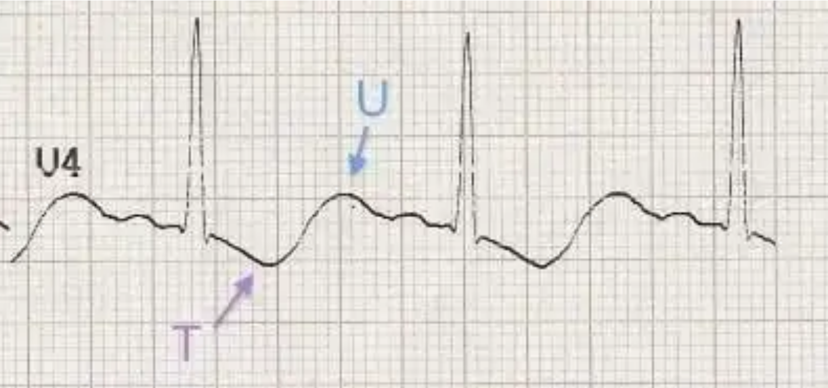

Question 3: Pathophysiology & ECG Risks
Mechanism of K⁺ Loss
Direct GI Loss: Diarrhea fluid contains high concentrations of K⁺ and HCO₃⁻.
Secondary Renal Loss: Dehydration activates RAAS, increasing Aldosterone, which promotes renal K⁺ excretion.
ECG Risks
Flattened or Inverted T waves
Prominent U waves
Risk of lethal arrhythmias (VT/VF)
Faculty of Nursing, NPRU

